Slide 1
Activity Selection Problem
- Sneha C I

Slide 2
Greedy Algorithm
The Greedy Algorithm is a problem-solving approach that makes optimal choices at each step. It prioritizes immediate gains, aiming to find the best solution for the current subproblem.

Slide 3
Activity Selection
Activity Selection is a problem where a set of activities with start and end times are given. The goal is to select the maximum number of non-overlapping activities that can be performed.

Slide 4
Problem Statement
You are given n activities with their start and finish times. Select the maximum number of activities that can be performed by a single person, assuming that a person can only work on a single activity at a time.
A2 → A3 TOTAL = 2 Activites
ACTIVITY | A1 | A2 | A3
START | 12 | 10 | 20
FINISH | 25 | 20 | 30

Slide 5
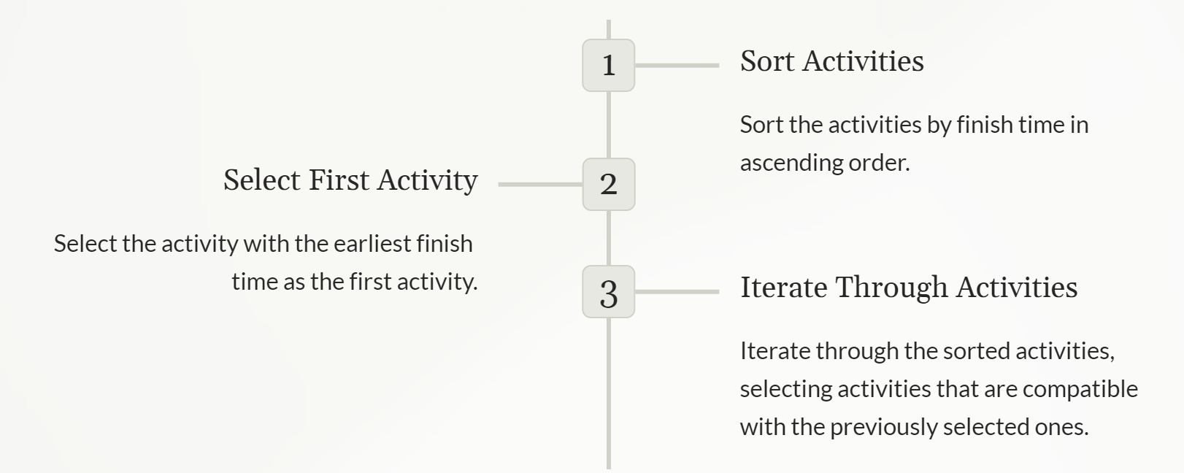
Steps to Implement

Slide 6
Greedy Approach
Step 1 → Sort the activities according to their finishing time
ACTIVITY | A1 | A2 | A3 | A4 | A5 | A6
START | 0 | 3 | 1 | 5 | 5 | 8
FINISH | 6 | 4 | 2 | 9 | 7 | 9
ACTIVITY | A3 | A2 | A1 | A5 | A6 | A4
START | 1 | 3 | 0 | 5 | 8 | 5
FINISH | 2 | 4 | 6 | 7 | 9 | 9

Slide 7
Greedy Approach
Step 2 → Select the 1st activity from the sorted array and print it.
Solution → A3
ACTIVITY | A3 | A2 | A1 | A5 | A6 | A4
START | 1 | 3 | 0 | 5 | 8 | 5
FINISH | 2 | 4 | 6 | 7 | 9 | 9

Slide 8
Greedy Approach
Step 3 → If start time of the next activity is greater then or equal to the finish time of previously selected activity then select this activity and print it
Solution → A3 → A2 → A5 → A6
ACTIVITY | A3 | A2 | A1 | A5 | A6 | A4
START | 1 | 3 | 0 | 5 | 8 | 5
FINISH | 2 | 4 | 6 | 7 | 9 | 9

Slide 9
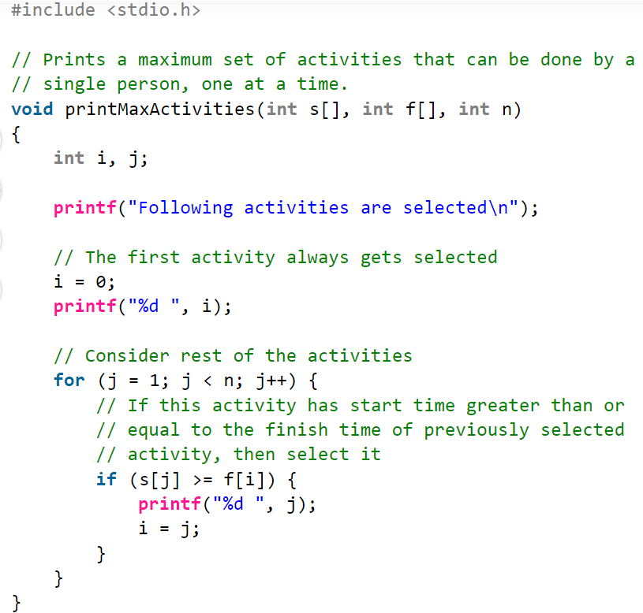
Implementation

Slide 10
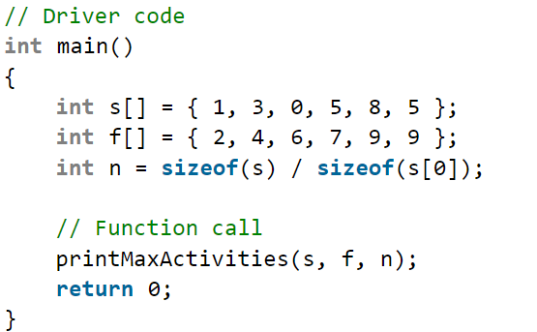
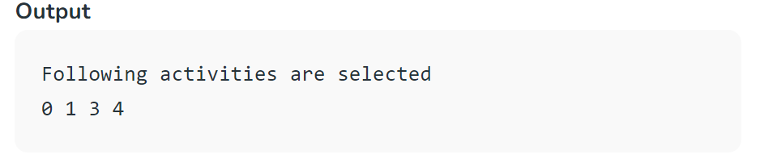
Implementation

Slide 11
Time Complexity
For sorted input → O(n)
For unsorted input → O(n log n)

Slide 12
Thank You

